Slide 1

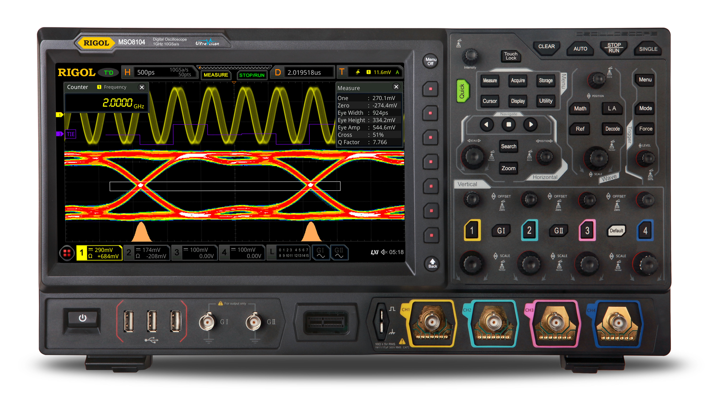
SQL to DBSP
compiler architecture
June 2023
Mihai Budiu
mbudiu@feldera.com

Slide 2
What is this?
A long reference document
Without a clear structure
Don’t try to follow or remember all the details
It is intended to document the architecture and implementation of the SQL to DBSP compiler
To help other people contribute or debug
It will be checked-in into the DBSP repository
Will be intermittently refreshed

Slide 3
DBSP
+
$$z^{−1}$$
DBSP is a programming language for writing incremental computations on databases
“Incremental View Maintenance”
Theoretical basis:
DBSP: Automatic Incremental View Maintenance for Rich Query Languages Mihai Budiu, Tej Chajed, Frank McSherry, Leonid Ryzhyk, and Val Tannen Proceedings of the VLDB Endowment (VLDB), Vancouver, Canada, August, 2023, pages 1601-1614
https://github.com/feldera/dbsp is an open-source implementation of this programming language

Slide 4

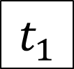
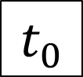
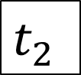
Streams
Consecutive values of an object
E.g., a table or a database view
Time is a “logical” clock, e.g., transaction count
$$t_{0}$$
$$t_{1}$$
$t_{2}$
…

Slide 5
Z-sets
Generalize sets
Each row has an integer weight
The weight can be positive, zero, or negative
Can represent both tables and changes to tables
Positive weights = elements added
Negative weights = elements removed
Generalize sets and multisets
Name | Age | Weight
Mike | 10 | 1
John | 12 | 3
Amy | 8 | -1
Chris | 10 | 2
tuples

Slide 6
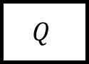
DBSP = computations on streams
Any number of inputs and outputs
Incremental computation:
Streams contain changes to inputs and outputs
(The compiler can optionally generate non-incremental computations)
query
…
$$Q$$
…
…
Streams of table values consecutive in time

Slide 7
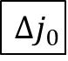
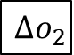
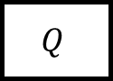
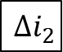
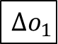
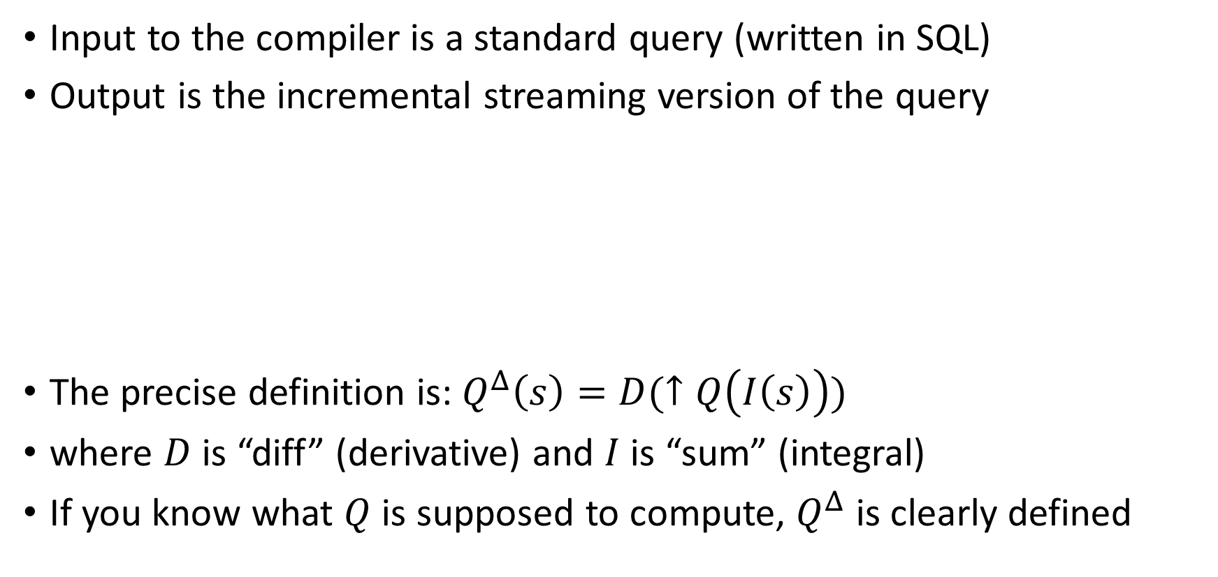

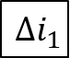
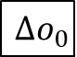
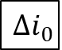

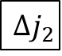
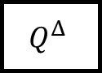
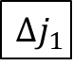
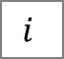
Incremental computations
Input to the compiler is a standard query (written in SQL)
Output is the incremental streaming version of the query
The precise definition is: $Q^{Δ}\left(s\right)=D(↑Q\left(I\left(s\right)\right))$
where $D$ is “diff” (derivative) and $I$ is “sum” (integral)
If you know what $Q$ is supposed to compute, $Q^{Δ}$ is clearly defined
sql-to-dbsp
compiler
$$i$$
$$Δi_{0}$$
$$Δi_{1}$$
$$Δi_{2}$$
…
$$Q$$
$$o$$
$$Q^{Δ}$$
$$Δo_{0}$$
$$Δo_{1}$$
$$Δo_{2}$$
…
$$j$$
$$Δj_{0}$$
$$Δj_{1}$$
$$Δj_{2}$$
…

Slide 8

SQL to DBSP compiler
https://github.com/feldera/dbsp/tree/main/sql-to-dbsp-compiler
MIT license
Generates programs using DBSP as a runtime
Written entirely in Java
Based on Apache Calcite https://calcite.apache.org

Slide 9
Example input program
-- create a table
CREATE TABLE Products ( ProductName VARCHAR NOT NULL, Price INT NOT NULL );
-- statements separated by semicolons
-- create a view
CREATE VIEW “Products Above Average Price” AS SELECT ProductName, Price FROM Products WHERE Price > (SELECT AVG(Price) FROM Products)
-- no semicolon at end

Slide 10
Describing streaming systems in SQL
CREATE VIEW V AS SELECT …
CREATE TABLE T ( … ) CREATE TABLE S ( … )
T
V
Dataflow graph
CREATE VIEW W AS SELECT …
S
W

Slide 11
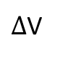
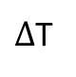
Compilation workflow: Rust output
Semantics of SQL (e.g., NULLs)
SQL runtime
$Δ$T
Compiler
rustc
SQL
Rust
exe
$Δ$V
DBSP runtime
Language-independent streaming lib
https://github.com/feldera/dbsp

Slide 12
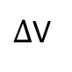
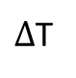
Compilation workflow: JIT output
$Δ$T
Compiler
JIT exec
SQL
JSON
DBSP runtime
$Δ$V

Slide 13
Compilation workflow
Type inference
CalciteCompiler
Calcite SQL parser (DDL)
SqlToRel
Optimize (Hep)
CalciteTo DBSP Compiler
Circuit
Opt.
Rust backend
SQL
JIT backend
Calcite IRs
DBSP IR
frontend
backend

Slide 14
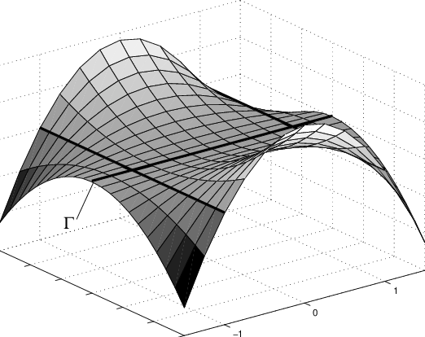
Optimizing Streaming Queries
Streaming systems generate plans before data is available!
No cost model or data statistics
Whatever plan you pass to DBSP, that’s what it runs!
Query planning performed using Calcite
In principle any optimizer should work
But we want to avoid bugs in some Calcite optimization Rules
We found quite a few bugs in Calcite optimization rules
Our compiler does some local optimizations

Slide 15

Calcite HEP Planner
A Calcite optimizer where you write a manual optimization plan
A plan is a list of rewrite rules
Currently applying:
Decorrelate queries (into joins)
Join order
Constant folding (*_REDUCE_EXPRESSIONS)
Empty collections (PruneEmptyRules)
Distinct aggregates converted to joins
Dead code (*_REMOVE)
Many more rules are available
Hard to validate rules, and, especially, rule combinations!

Slide 16
DBSP Core Intermediate Representation (IR)
Immutable
Can represent a small subset of Rust
Some classes are used for SQL compilation
Some classes are only used for test generation (e.g., for expressions). Annotated with @NonCoreIR
A bit higher-level than Rust (e.g., “Fold” is one operator)
Strongly-typed
DAG structure
No parent pointers
IR sub-dags can be reused
Manipulated almost exclusively by visitors
shared sub-DAG

Slide 17

Base class DBSPNode
public abstract class DBSPNode { /** Original Calcite object that produced this node. */ private final CalciteObject node;
/** Globally-unique ID for each node */ public final long id;
public String toString();
}
Compiler should be deterministic
Can insert breakpoints based on node id

Slide 18

Two-level Core IR representation
DBSP is a 2-level language:
Operators (e.g., “map”, “flatmap”, “join”)
Parameterized by functions (operating on tuples)
Circuits = dataflow graph of operators
All nodes implement IDBSPOuterNode interface
Functions = computations invoked by operators on their input data
IDBSPInnerNode interface
IR cannot yet represent recursion

Slide 19
IR Example
Circuit - outer
Function (Rust closure) - inner
move |t: &Tuple3<Option<i32>, Option<i32>, Option<i32>>, | -> Tuple1<Option<i32>> { Tuple1::new(plus_i32N_i32N( minus_i32N_i32N( div_i32_i32N(32i32, t.2), (match t.1 { Some(x) => Some(-(x)), _ => None, })), times_i32_i32N(-73i32, t.1))) }
MapOperator

Slide 20
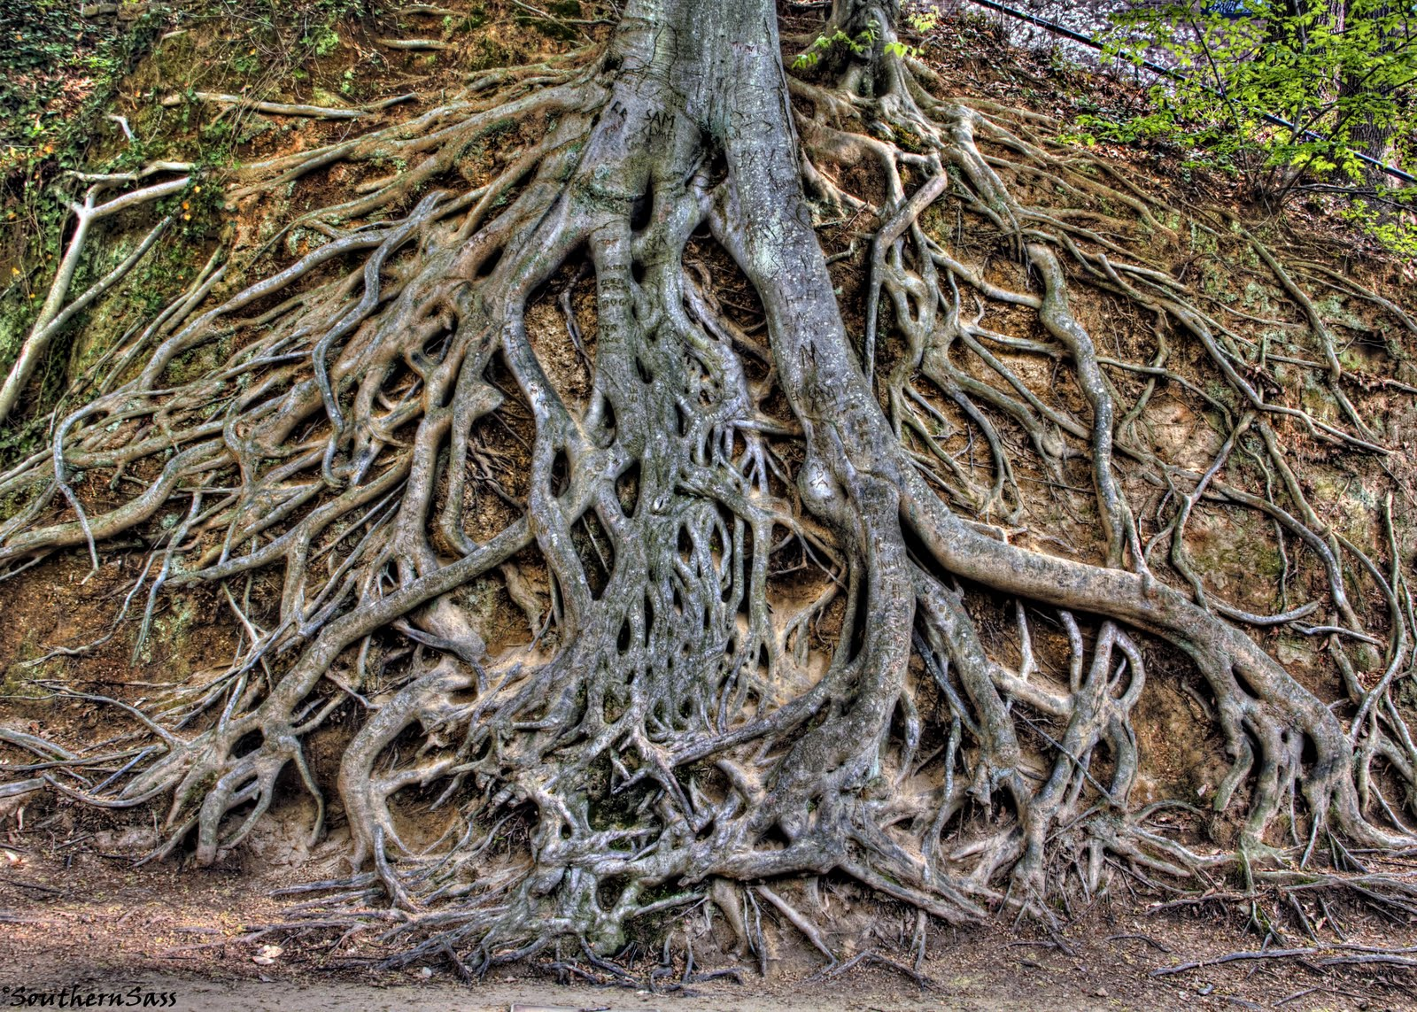
Root of class hierarchy
~24 classes
DBSPComment
IDBSPOuterNode
DBSPOperator
DBSPCircuit
…
IDBSPNode
DBSPPattern
…
IDBSPInnerNode
DBSPType
…
DBSPExpression
…
~120 classes
DBSPStatement
…
DBSPath
…
DBSPAggregate
DBSPFunction

Slide 21
Example inner IR classes
abstract class DBSPExpression extends DBSPNode implements IHasType, IDBSPInnerNode { protected final DBSPType type; … }
class DBSPBinaryExpression extends DBSPExpression { public final DBSPExpression left; public final DBSPExpression right; public final DBSPOpcode operation;
}

Slide 22
Operators
abstract class DBSPOperator extends DBSPNode implements IHasName, IHasType, IDBSPOuterNode { public final List<DBSPOperator> inputs; public final String operation; public final DBSPExpression function; public final String outputName; public final DBSPType outputType; public final boolean isMultiset; public final String comment; }

Slide 23
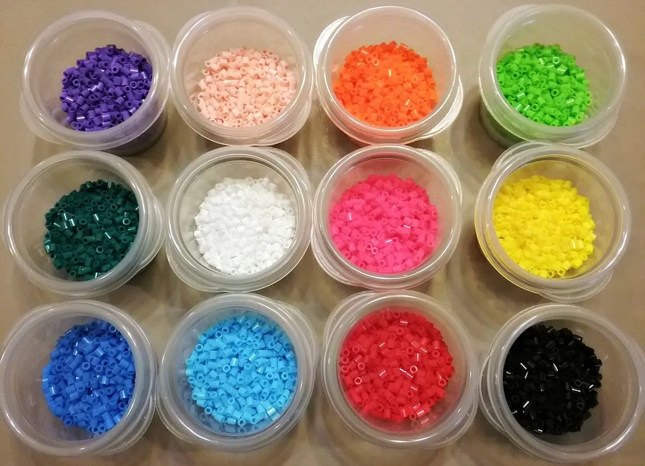
Types
All SQL types are base types (DBSPTypeBaseType)
Used in SQL: Integers, Booleans, but also Date, Time, String, MonthsInterval, null
Supporting: USize, Weight, Str
Calcite and Java do not support unsigned types, but the IR has them
Derived types
Tuple (hand-made), raw tuple (Rust), struct, vector, zset, user-defined
Semigroup types (for aggregates) – should probably be removed
TypeAny for types we don’t want to write (_)
Implementations must implement rust Ord trait (f32 doesn’t!)

Slide 24

Visitor pattern
https://en.wikipedia.org/wiki/Visitor_pattern
“In object-oriented programming and software engineering, the visitor design pattern is a way of separating an algorithm from an object structure on which it operates. A practical result of this separation is the ability to add new operations to existing object structures without modifying those structures.”
“Structure” = IR
“Algorithms” = program manipulations

Slide 25

Two-level visitor infrastructure
CircuitVisitor (base class) operates on circuits
implements Function<DBSPCircuit, DBSPCircuit>
Read-only visitors
Rewriting visitors
InnerVisitor (base class) operates on functions inside operators
implements Function<IDBSPInnerNode, IDBSPInnerNode>
Read-only visitors
Rewriting visitors

Slide 26
IR Manipulation (base classes)
Base | Visitor | Description
IRTransform | InnerVisitor | Operates on functions; read-only.
 | InnerRewriteVisitor | Rewrites types, expressions, statements.
 | InnerPasses | Runs in sequence several IRTransform.
 | InnerRepeat | Repeats an IRTransform until convergence.
CircuitTransform | CircuitVisitor | Operates on the circuit; read-only.
 | CircuitCloneVisitor | Operates on the circuit operators only; rewrites circuit.
 | CircuitRewriter | Rewrites a circuit using an IRTransform, including operator functions.
 | Passes | Runs a sequence of several CircuitTransform.
 | Repeat | Repeats a CircuitTransform until convergence.

Slide 27
IR rewriting using visitors
Input DAG
Output DAG
visitor
Modified DAG
Dead code
New DAG

Slide 28
Structure of read-only visitors
One preorder method for each node, returning VisitDecision
If the method returns STOP, visit stops immediately
One postorder method for each node, returning void
Flow:
class DBSPBinaryExpression extends DBSPExpression {
@Override public void accept(InnerVisitor visitor) { if (visitor.preorder(this).stop()) return; visitor.push(this); if (this.type != null) this.type.accept(visitor); this.left.accept(visitor); this.right.accept(visitor); visitor.pop(this); visitor.postorder(this); }
}

Slide 29

Chaining visitors
IDBSPInnerNode node;
InnerVisitor v1, v2;
IDBSPInnerNode intermediate = v1.apply(node);
IDBSPInnerNode final = v2.apply(intermediate);
node
intermediate
final
v1
v2

Slide 30
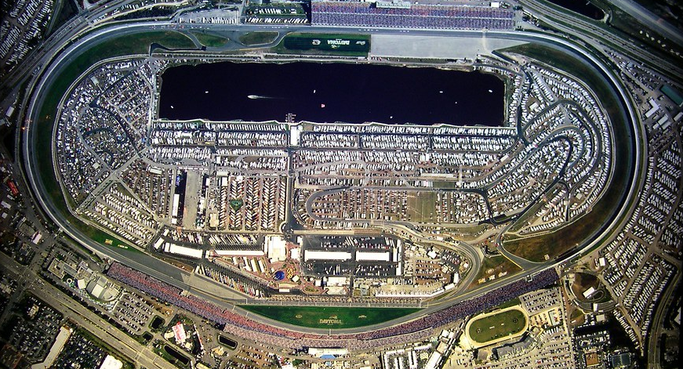
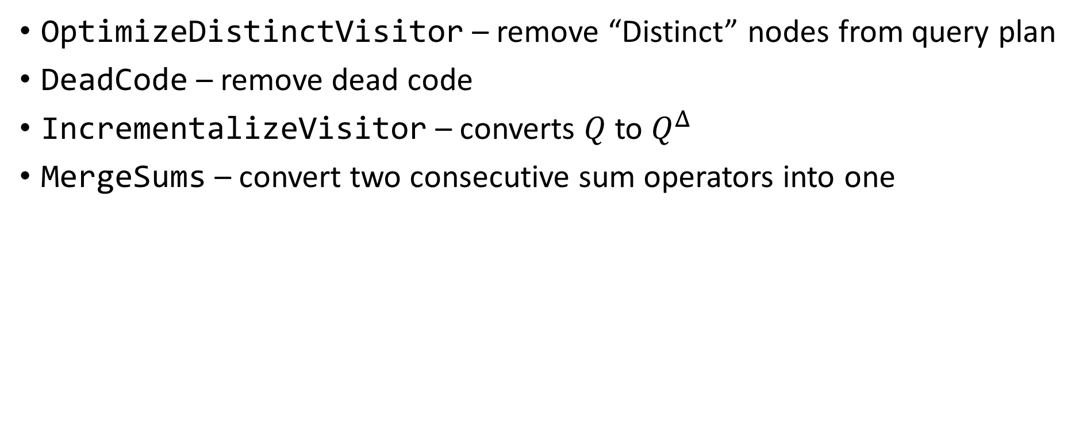
Example circuit visitors
OptimizeDistinctVisitor – remove “Distinct” nodes from query plan
DeadCode – remove dead code
IncrementalizeVisitor – converts $Q$ to $Q^{Δ}$
MergeSums – convert two consecutive sum operators into one

Slide 31
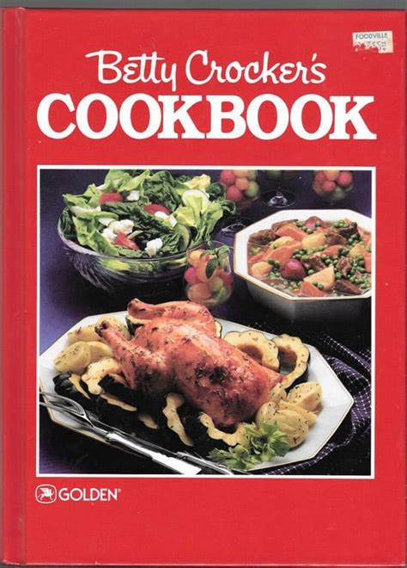
Recipe: Extending the IR
Add a new class to the proper package (e.g., expressions, types, etc.)
Derive from the right interface (IDBSPInnerNode or IDBSPOuterNode)
Implement the accept method
Add the suitable preorder & postorder methods to the OuterVisitor and InnerVisitor base classes
Add other implementations of preorder/postorder at other visitors (e.g., code generators)

Slide 32
CircuitCloneVisitor and inheritors
Use the postorder method
Use the “mapped” method to get the rewritten operator inputs
Use the “map” method to set the rewrite result
Don’t forget to call super.postorder for default behaviors
Example: swap “filter” with “distinct”:
void postorder(DBSPFilterOperator filter) { DBSPOperator input = this.mapped(filter.input()); if (input.is(DBSPDistinctOperator.class)) { DBSPOperator newFilter = filter.withInputs(input.inputs, false); this.addOperator(newFilter); DBSPOperator result = input.withInputs(Linq.list(newFilter), false); this.map(filter, result); } else super.postorder(filter); }

Slide 33

InnerRewriteVisitor and inheritors
Use the “preorder” method
Results are returned using the “map” method of the visitor
Recurse using the “transform” method
Example:
VisitDecision preorder(DBSPIsNullExpression expression) { this.push(expression); DBSPExpression source = this.transform(expression.expression); this.pop(expression); DBSPExpression result = expression; if (!source.getNonVoidType().mayBeNull) result = DBSPBoolLiteral.FALSE; this.map(expression, result); return VisitDecision.STOP; }

Slide 34

Rust code generation
Mostly handed by ToRustVisitor and ToRustInnerVisitor (or ToRustHandleVisitor)
RustFileWriter handles one-off tasks:
Some optimizations
Lowering representation (e.g., Aggregates)
Generating preambles (Rust use statements, Tuple definitions)
Generating Rust code

Slide 35
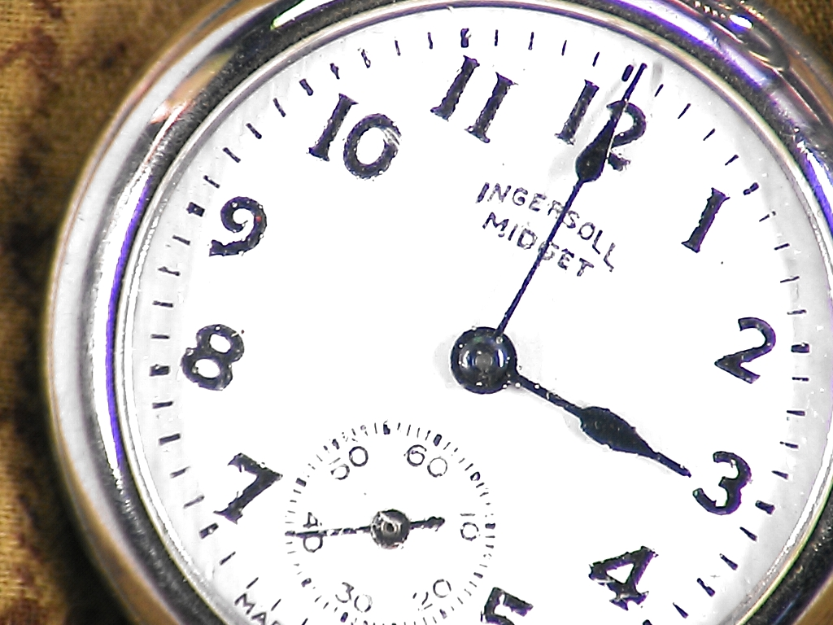
JIT Code Generation
The JIT Code generation backend has a separate IR
Lower level
E.g., no generic types, no nullable types
Each scalar value in IR is usually 2 values in JIT IR
Value and nullable bit
Also a two-level IR: JITOperator and JITNode
No visitors (yet)
JIT IR is directly serialized as JSON
Can also be serialized as assembly

Slide 36
JIT IR Example
6942 Source() 6944 Map(6942) (t 1 input:[I32, F64, Bool, String, ?I32, ?F64], $retval_1 2 output:[?I32]) block 1() # t.4 3 Load 1[4] 4 IsNull 1[4] # t.4 5 Load 1[4] 6 IsNull 1[4] 7 Constant Some(0i32) 8 7 Eq 5 if 8 then 2() else 3() block 2() 9 Constant true jump 4(9, 7) block 3() 10 4 Or 6 # div_i32N_i32N(t.4, t.4) 11 3 Div 5 jump 4(10, 11) block 4(12, 13) # into Tuple1::new(div_i32N_i32N(t.4, t.4)).0 14 Store 2[0]=13 15 SetNull 2[0]=12 return # 6947 Sink(6944)
CREATE VIEW V AS SELECT T.COL5 / T.COL5 FROM T

Slide 37

Testing
A few small unit tests (~600)
Mostly regression tests
Postgres test suite
SqlLogicTest (5-7M tests, not run in CI)

Slide 38
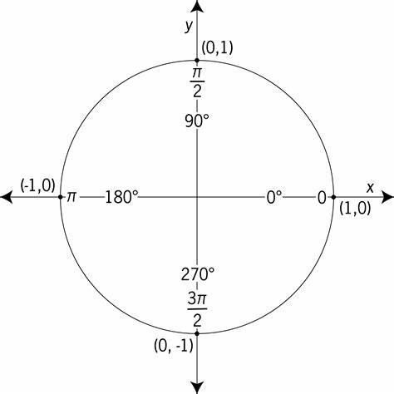
Unit tests
3 parts:
Query (table & view definitions)
Input data
Output data
IR can be used to represent constant values (ZSets, tuples)
Each test generates
A Rust function implementing the query as a fn mut(in0, in1) -> (out0, out1)
A Rust function invoking the query function on specified inputs and comparing outputs with expected results

Slide 39
BaseSQLTests
Provides many test utilities
Collects all rust test cases and runs them at the end in batch
To override:
testOptions() – options used for the current set of tests
testCompiler() – compiler used for the current set of tests
prepareTests(DBSPCompiler) – prepare a set of tests (usually by creating and filling tables.)

Slide 40

Example unit test in Java
DBSPCompiler compiler = testCompiler(); compiler.compileStatements(statements); DBSPCircuit circuit = getCircuit(compiler); InputOutputPair io = new InputOutputPair( new DBSPZSetLiteral.Contents[] { new DBSPZSetLiteral.Contents(e0, e1) }, new DBSPZSetLiteral.Contents[] { new DBSPZSetLiteral.Contents( new DBSPTupleExpression(DBSPBoolLiteral.TRUE), new DBSPTupleExpression(DBSPBoolLiteral.FALSE)), new DBSPZSetLiteral.Contents( new DBSPTupleExpression(new DBSPI32Literal(10))) }); this.addRustTestCase(compiler, circuit, io);
This is tedious; there are better ways to do it – see Postgres tests later in the presentation.

Slide 41

Sql Logic Test
From sqlite, public domain https://www.sqlite.org/sqllogictest/doc/trunk/about.wiki
5-7M+ tests
Factored out into a separate Java project https://github.com/hydromatic/sql-logic-test
No corner cases; only INTEGER, STRING, and DOUBLE
We use a real database for DDL & DML
Used Postgres and HSQLDB
We only compile and test the queries (not the statements)
Takes several weeks to run all tests using DBSP
Most of the time is spent in Rust compilation
Submitted a patch to Calcite
would take ~2weeks to run all tests on Calcite

Slide 42

Postgres test suite
https://github.com/postgres/postgres/blob/master/src/test/regress/expected
Input-output pairs
~240 test files in source
I implemented 4.5 of them
Not 100% compatible with Calcite SQL dialect
Require manual translation for each test case
Skipping the unsupported constructs

Slide 43
Writing a new Postgres tests
You can almost copy-paste code from the .out files
In a new test file:
Define a function prepareData(DBSPCompiler compiler) which creates and populates the tables that appear in the test. These may be created by the test_setup.out script
Create a new test using this.queryWithOutput:
this.queryWithOutput( "SELECT CAST(f1 AS varchar) AS \"varchar(char)\" FROM CHAR_TBL;\n" + " varchar(char) \n" + "---------------\n" + "a\n" + "ab\n" + "abcd\n" + "abcd");

Slide 44
Usage
$ cd sql-to-dbsp-compiler/SQL-compiler $ ./sql-to-dbsp
Usage: sql-to-dbsp [options] Input file to compile Options: -h, --help, -? Show this message and exit -O Optimization level (0, 1, or 2) -T Specify logging level for a class (can be repeated) -alltables Generate an input for each CREATE TABLE, even if the table is not used by any view -d SQL syntax dialect used Possible Values: [BIG_QUERY, ORACLE, MYSQL, MYSQL_ANSI, SQL_SERVER, JAVA] -f Name of function to generate -I Generate an incremental circuit -j Emit the JIT JSON representation instead of Rust -je Emit error messages as a JSON array to stderr -jpg Emit a jpg image of the circuit instead of Rust -js File containing schemas of all views and tables involved (in json) -o Output file; stdout if null -png Emit a png image of the circuit instead of Rust

Slide 45
Generated code
// CREATE TABLE T ( // COL1 INT NOT NULL, COL2 DOUBLE NOT NULL, COL3 BOOLEAN // NOT NULL, COL4 VARCHAR NOT NULL, COL5 INT, COL6 DOUBLE) let T = circuit.add_source(T);
let stream0: Stream<_, OrdZSet<Tuple1<bool>, Weight>> = T.map(move |t: &Tuple6<i32, F64, bool, String, Option<i32>, Option<F64>>, | -> Tuple1<bool> { Tuple1::new(or_b_b(t.2, gt_i32_i32(t.0, 10i32))) });
// CREATE VIEW V AS SELECT T.COL3 OR T.COL1 > 10 FROM T

Slide 46
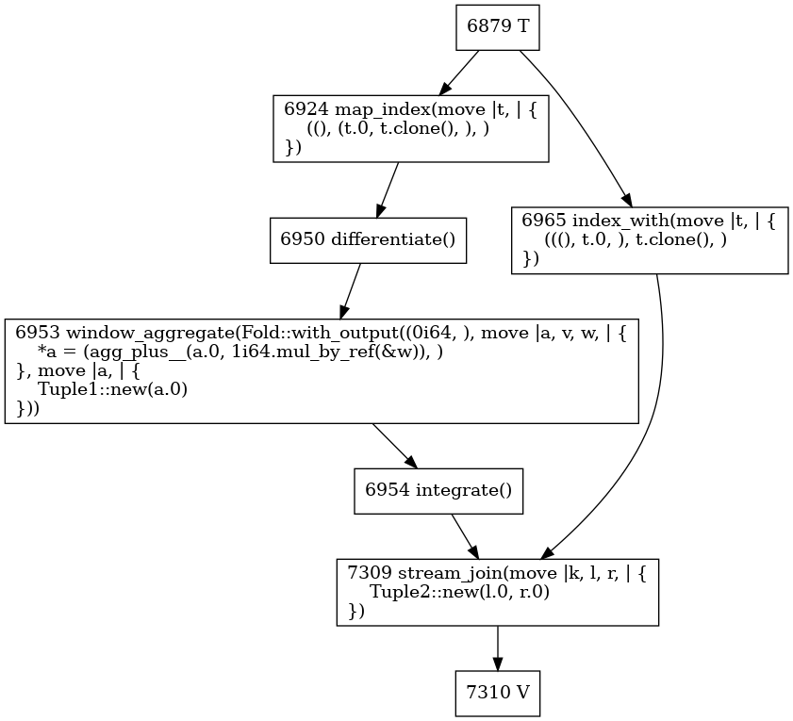
Example circuit topology output
node id
node operation
function
SELECT T.COL1, COUNT(*) OVER (ORDER BY T.COL1 RANGE UNBOUNDED PRECEDING) FROM T

Slide 47

Status
Core SQL language covered
Rust code generation covered for core SQL language
Tracked by https://github.com/feldera/dbsp/issues/172
JIT backend handles part of core SQL
Ran once all SQL Logic Tests successfully
But the compiler has changed since then
No SQL streaming extensions yet supported

Slide 48
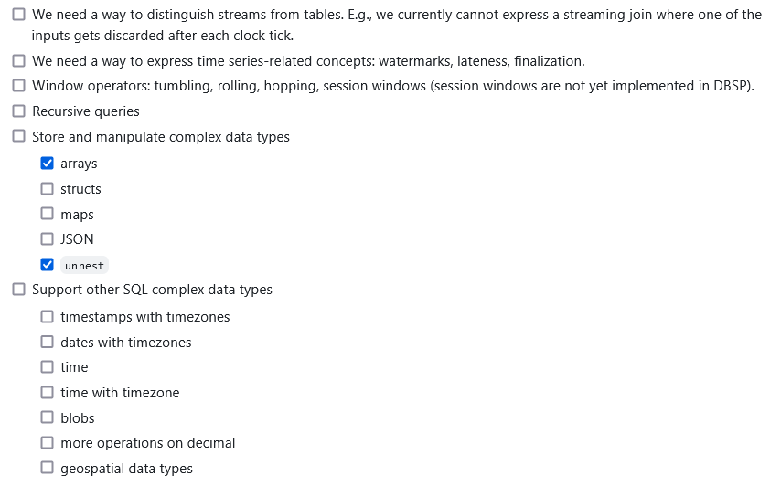
SQL feature wish list
dbsp/issues/172

Slide 49
SQL Runtime library
Implements the semantics of SQL on our chosen Rust representation
sql-to-dbsp-compiler/lib/
hashing – used for SLT testing using MD5 output checksums
readers – used for SLT testing to read CSV files
sqlvalue – used for SLT testing to convert values to strings
tuple – implementation of tuples with arbitrary number of arguments
sqllib – SQL functions
casts – type conversions
operators – plus, minus, and, or, etc with NULLs
geopoint – will have support for geographic data structures (only one now)
interval – time intervals
timestamp – dates and timestamps
string – string functions

Slide 50
One operator
pub fn eq_i16_i16(left: i16, right: i16) -> bool pub fn eq_i32_i32(left: i32, right: i32) -> bool pub fn eq_i64_i64(left: i64, right: i64) -> bool pub fn eq_i16N_i16(left: Option<i16>, right: i16) -> Option<bool> pub fn eq_i32N_i32(left: Option<i32>, right: i32) -> Option<bool> pub fn eq_i64N_i64(left: Option<i64>, right: i64) -> Option<bool> pub fn eq_i16_i16N(left: i16, right: Option<i16>) -> Option<bool> pub fn eq_i32_i32N(left: i32, right: Option<i32>) -> Option<bool> pub fn eq_i64_i64N(left: i64, right: Option<i64>) -> Option<bool> pub fn eq_i16N_i16N(left: Option<i16>, right: Option<i16>) -> Option<bool> pub fn eq_i32N_i32N(left: Option<i32>, right: Option<i32>) -> Option<bool> pub fn eq_i64N_i64N(left: Option<i64>, right: Option<i64>) -> Option<bool> pub fn eq_b_b(left: bool, right: bool) -> bool pub fn eq_bN_b(left: Option<bool>, right: bool) -> Option<bool> pub fn eq_b_bN(left: bool, right: Option<bool>) -> Option<bool> pub fn eq_bN_bN(left: Option<bool>, right: Option<bool>) -> Option<bool> pub fn eq_s_s(left: String, right: String) -> bool pub fn eq_sN_s(left: Option<String>, right: String) -> Option<bool> pub fn eq_s_sN(left: String, right: Option<String>) -> Option<bool> pub fn eq_sN_sN(left: Option<String>, right: Option<String>) -> Option<bool> pub fn eq_d_d(left: F64, right: F64) -> boolpub fn eq_f_f(left: F32, right: F32) -> bool pub fn eq_dN_d(left: Option<F64>, right: F64) -> Option<bool> pub fn eq_fN_f(left: Option<F32>, right: F32) -> Option<bool> pub fn eq_d_dN(left: F64, right: Option<F64>) -> Option<bool> pub fn eq_f_fN(left: F32, right: Option<F32>) -> Option<bool> pub fn eq_dN_dN(left: Option<F64>, right: Option<F64>) -> Option<bool> pub fn eq_fN_fN(left: Option<F32>, right: Option<F32>) -> Option<bool> pub fn eq_decimal_decimal(left: Decimal, right: Decimal) -> bool pub fn eq_decimalN_decimal(left: Option<Decimal>, right: Decimal) -> Option<bool> pub fn eq_decimal_decimalN(left: Decimal, right: Option<Decimal>) -> Option<bool> pub fn eq_decimalN_decimalN(left: Option<Decimal>, right: Option<Decimal>) -> Option<bool> pub fn eq_Timestamp_Timestamp(left: Timestamp, right: Timestamp) -> bool pub fn eq_TimestampN_Timestamp(left: Option<Timestamp>, right: Timestamp) -> Option<bool> pub fn eq_Timestamp_TimestampN(left: Timestamp, right: Option<Timestamp>) -> Option<bool> pub fn eq_TimestampN_TimestampN(left: Option<Timestamp>, right: Option<Timestamp>) -> Option<bool> pub fn eq_date_date(left: Date, right: Date) -> bool pub fn eq_dateN_date(left: Option<Date>, right: Date) -> Option<bool> pub fn eq_date_dateN(left: Date, right: Option<Date>) -> Option<bool> pub fn eq_dateN_dateN(left: Option<Date>, right: Option<Date>) -> Option<bool>
More will be needed.
Not all supported types are here.
Most of these are generated by Rust macros.

Slide 51
Library function signatures
pub fn eq_i32_i32N(left: i32, right: Option<i32>) -> Option<bool>
This pattern is used for polymorphic functions.
Non polymorphic functions have similar naming patterns, e.g.: chr_ and chrN.
Left argument
Right argument
Nullable type

Slide 52
Macros for generating functions
You write one function
The macros handle NULLs
These work when NULL inputs generate NULL outputs
Not always true
some_polymorphic_function1 – polymorphic functions with 1 arg
some_function – non-polymorphic functions with 1 arg
some_operator – functions implementing operators (e.g., plus)

Slide 53

Recipe: Adding new SQL features
Write a unit test
Run the test
Notice the location of the crash
Probably a throw Unimplemented()
Implement the missing function
Probably call some specific runtime function
Run the test again
Rust will fail to compile with unknown function
Implement the runtime function in sqllib/
Run the test again
Repeat

Slide 54
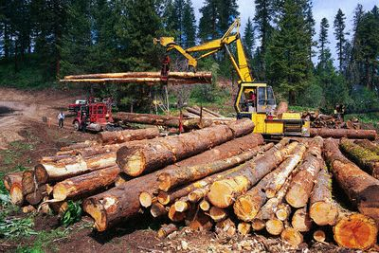
Logging
Message priority; higher -> less verbose
Logger.INSTANCE.belowLevel(this, 3) .append("After ") .append(this.visitor.toString()) .newline() .appendSupplier(result::toString) .newline();
Lazy evaluation using a function

Slide 55

Error handling
Compiler catches exceptions and converts them into messages
For debugging it can do the opposite too: throw at first error
Controlled by compilerOptions.optimizerOptions.throwOnError
Prefer to throw one of the exceptions deriving from BaseCompilerException:
InternalCompilerError – an assertion failure for broken invariants
UnimplementedException – something is not yet built, but should be
UnsupportedException – construct is not legal SQL or is not supported

Slide 56
Controlling the logging level
Logger.INSTANCE.setLoggingLevel(DBSPCompiler.class, 3); Logger.INSTANCE.setLoggingLevel(“CalciteCompiler”, 3);
On the command-line you can use the –T flag to control the logging level:
./sql-to-dbsp –TCalciteCompiler=2 –TDBSPCompiler=3…
Classes that implement IWritesLogs

Slide 57

Static and dynamic semantics
Constant expressions are evaluated by Calcite
Using a Java-based evaluator
Which depends on the Java type system
So it is difficult to add non-Java datatypes, e.g., UNSIGNED
May have bugs
Some functions have different behaviors depending on SQL dialect selected!
Other expressions are evaluated by the runtime
The results should agree
The runtime cannot unilaterally choose a semantics

